Slide 1
Flash Carma Design
by Adrian West, Brandon Sitz, Joseph Ramos-Garcia, and Josh Moore

Slide 2
Outline
Block diagram
Component diagram
User interface storyboard
Client / server messages
Database storage
Data model

Slide 3
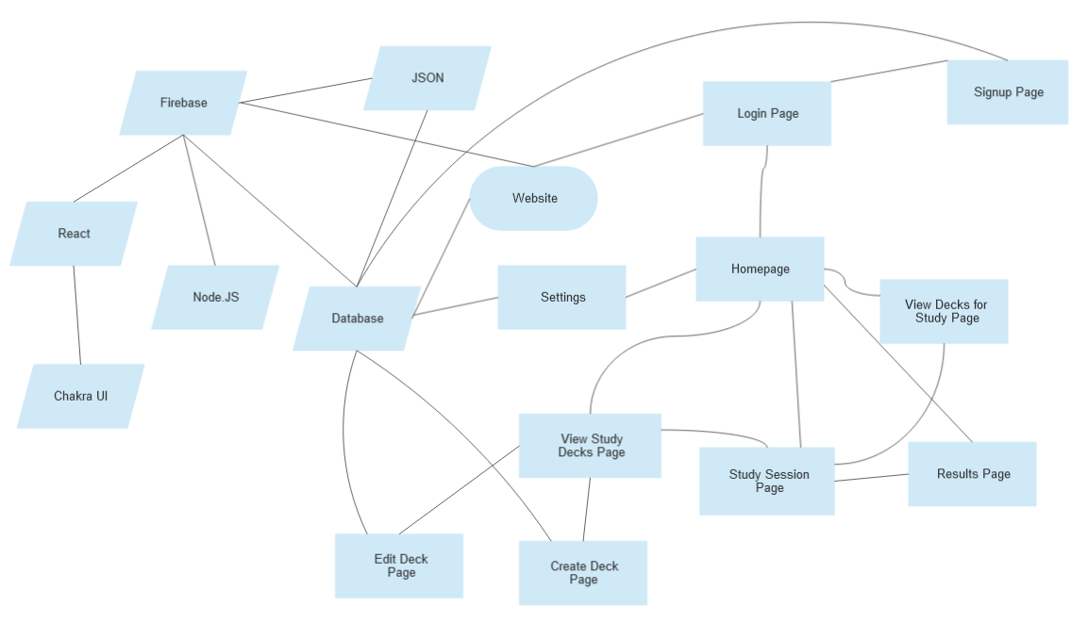
Block Diagram

Slide 4
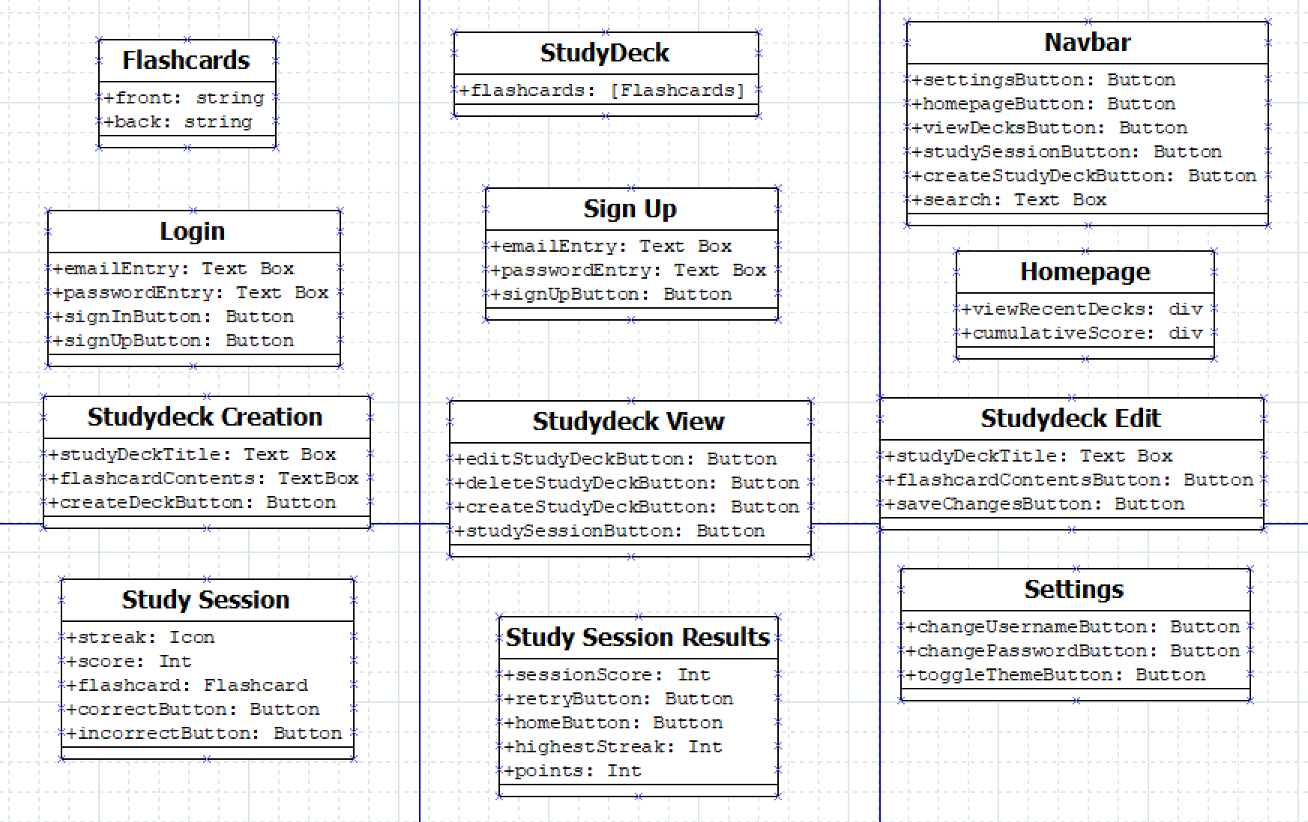
Component Diagram

Slide 5
Component Diagram
Flashcard
Has a front and back that is made up of two strings
Studydeck
An array of flashcards that allows for sorting
Navbar
Component that allows easy access to important pages
Login
Page where you enter your email and password to login
Also allows you to sign up if its your first time visiting
Sign up
Page where you enter your email and password to login upon first arrival
Homepage
Page where you will see your cumulative study score and most recent decks used

Slide 6
Component Diagram
Studydeck Creation
Page where you can enter the title of the deck and flashcards for the deck
Studydeck View
Page where you can view all the study decks you have made
Allows for the edit, creation, and deletion of a study deck
Can launch into a study session from this page
Studydeck Edit
Page that lets you change the title and flashcards of a deck
Studysession
Page where you study your studydeck
Has an icon for highest answer streak
Displays total score for the session
Has buttons for incorrect and correct choices

Slide 7
Component Diagram
Study Session Results
Page that displays the results of your previous study session
Allows you to retry for a higher score
Settings
Page where you can customize the user and site settings
Allows changing of username and password
Allows changing of website theme

Slide 8
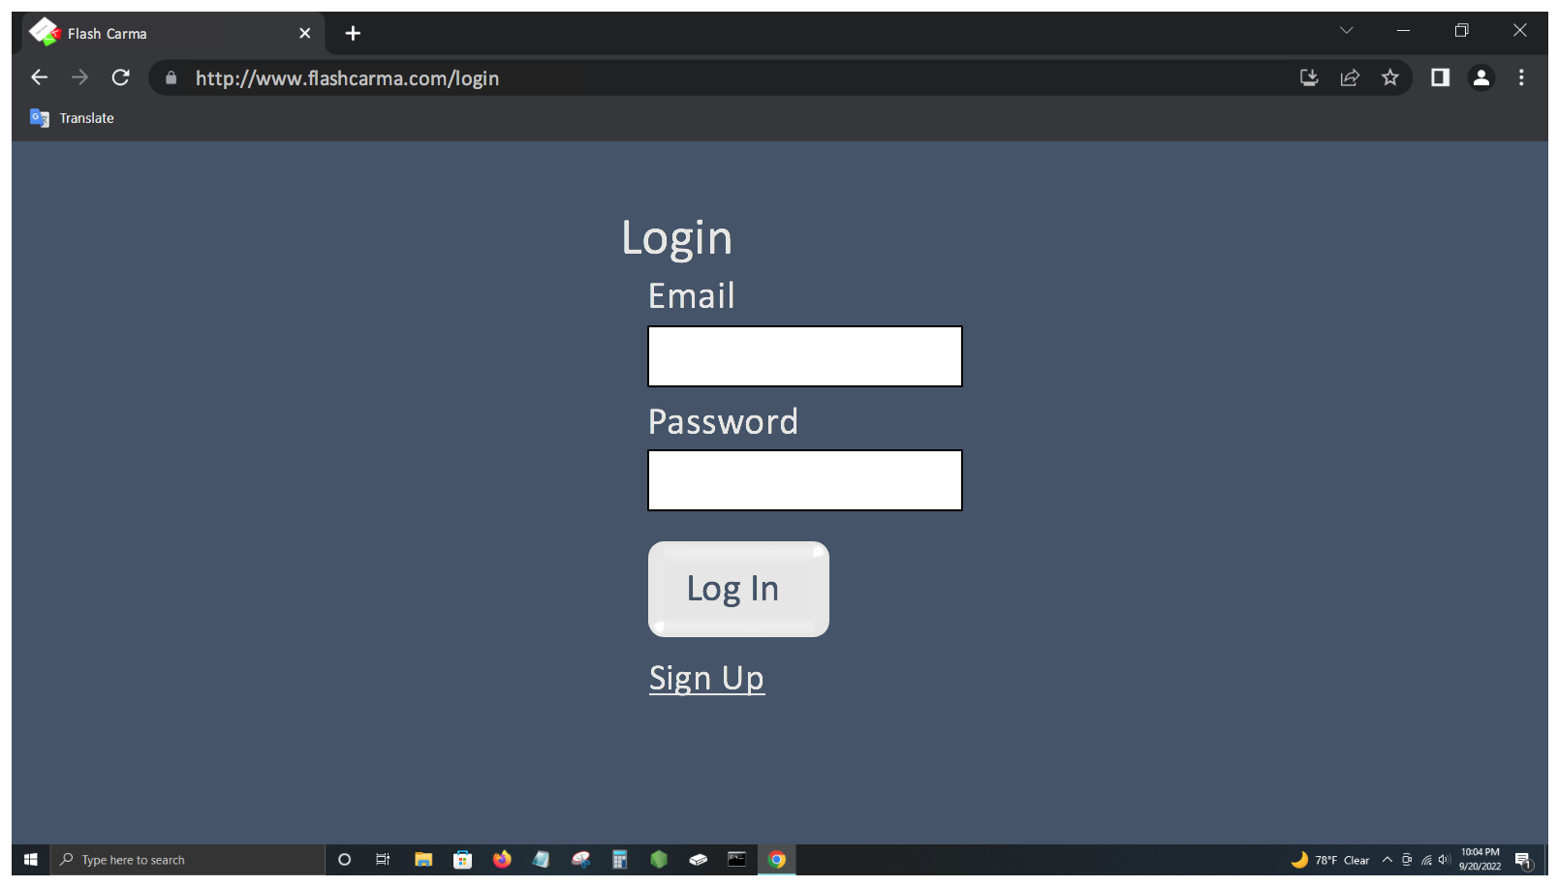
User Interface Storyboard

Slide 9
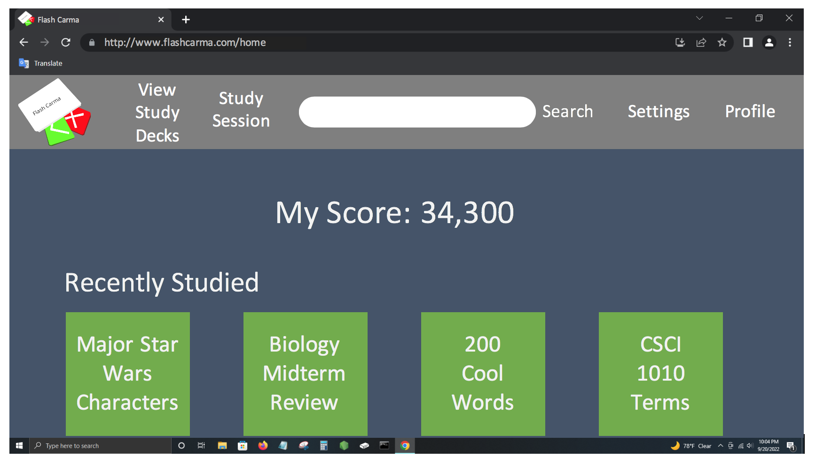
User Interface Storyboard

Slide 10
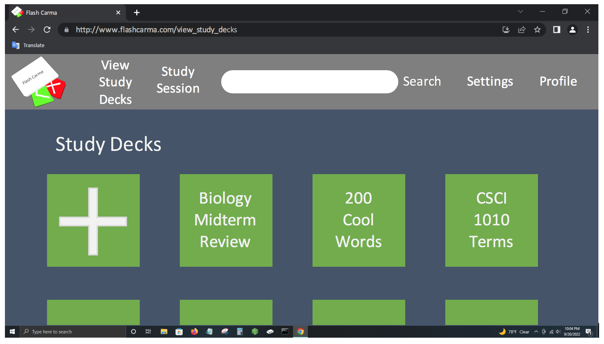
User Interface Storyboard

Slide 11
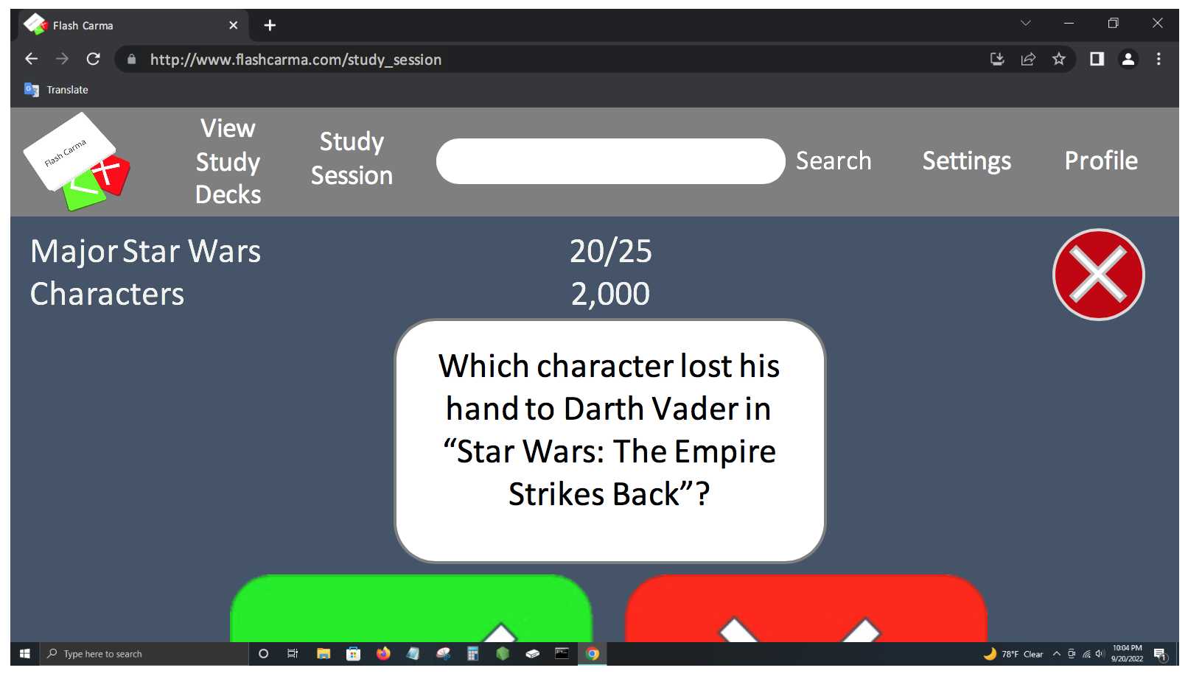
User Interface Storyboard

Slide 12
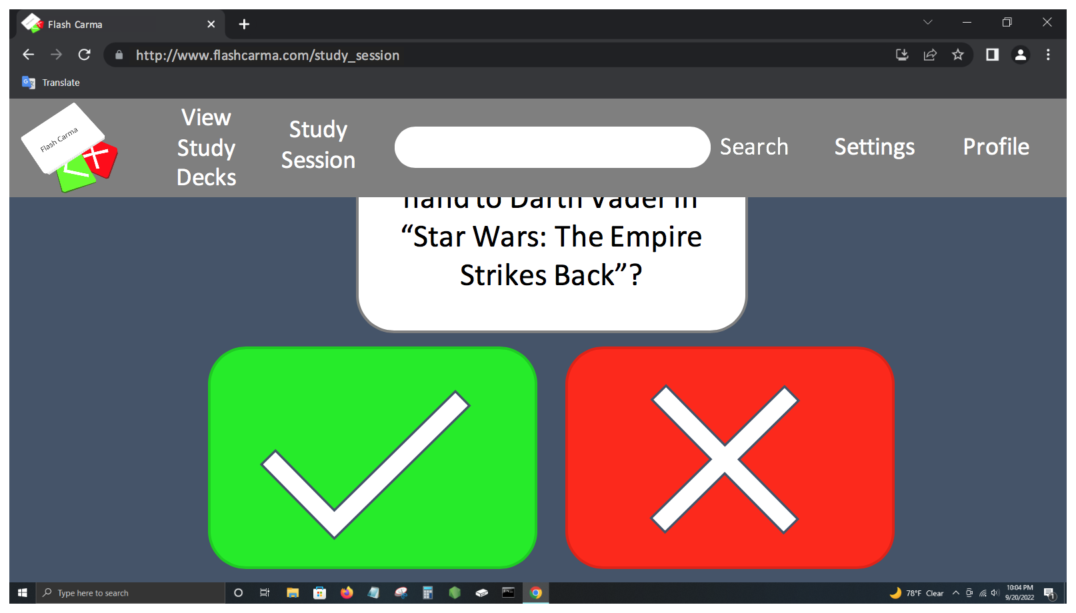
User Interface Storyboard

Slide 13
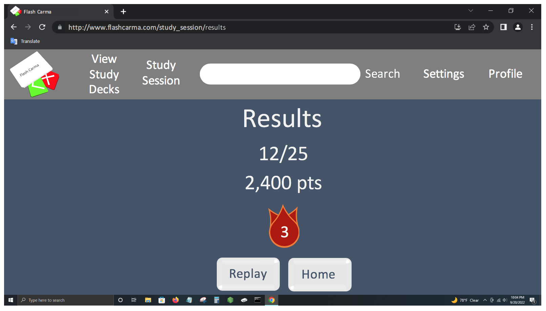
User Interface Storyboard

Slide 14
Client / Server Messages
Request user information from the database
JSON example:
{
"users" : [
{
"userid": "123",
"email": "user@example.com",
"password": "password",
"username": "user",
"score": "100"
}
]
}

Slide 15
Client / Server Messages
Request study decks from the database
JSON example:
{
"studyDecks": [
{
"studyDeckid": "0123",
"numberFlaschcards": "2",
"timestamp": "0123456789",
"flashcards" : [
{
"flashcardid": {
"question": "question",
"answer": "answer"
}
},
{
"flashcardid": {
"question": "question",
"answer": "answer"
}
}
]
}
]
}

Slide 16
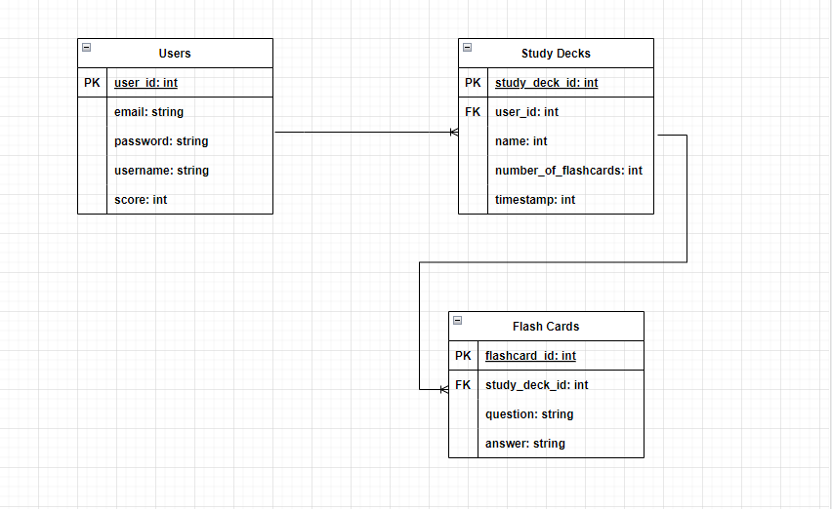
Database Storage

Slide 17
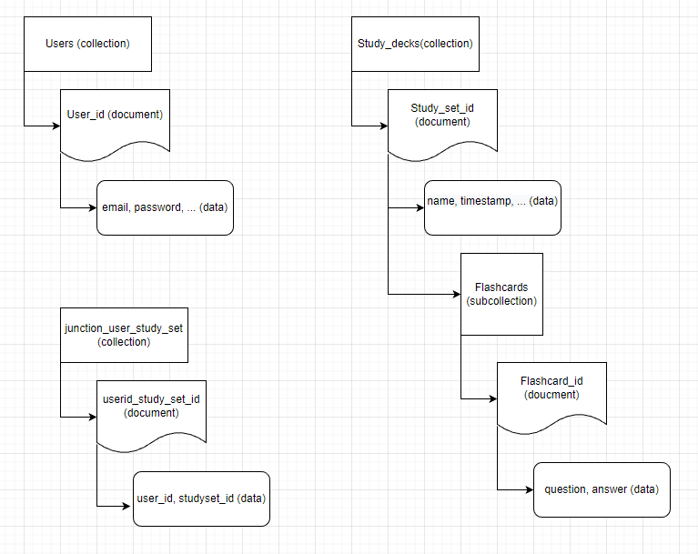
Data Model

Slide 18
Summary
Block diagram
Component diagram
User interface storyboard
Client / server messages
Database storage
Data model

Slide 19
Closing
Questions
Comments
Concerns
Thank you for your time!

